Slide 1

Amy Liu Alice Chen Andy lin Dhruv Sabharwal Ludwig von Schonfeldt Oren
GESTURE Ar
Body language & gesture identification

Slide 2
Scope of the problem
In the current landscape, better understanding other cultures. Intercultural engagement.
Aiming at developing interactive AR content to help with educating people about different cultural identities and promote cultural inclusion. For the bigger picture, we will compare more self-defined gestures to your Metaverse cultural identity where we are all equally represented.

Slide 3
Solution

Slide 4
Compositions

Slide 5
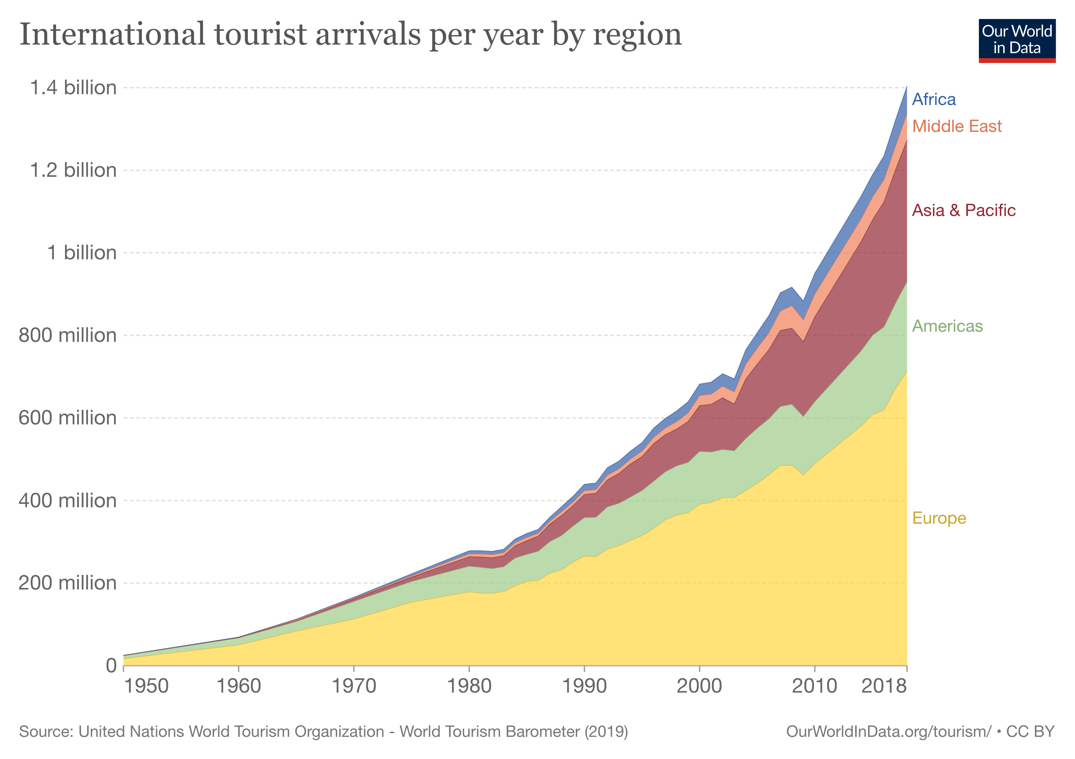
Market Segmentation & Feasibility

Slide 6
Team

